Slide 1


DSI Project 2 Ames Housing Project
Group 2: Cindy, Shin, Chun Shan and Jason
Notes:
Hi everyone, today, Shin, chun shan, Jason and I will be presenting about Ames Housing.

Slide 2
Problem statement
Problem statement | EDA | Regression Model | Variables | Discussion
We are from a data-driven real estate company that wants to determine the most important characteristics that affect housing prices in Ames, Iowa.
Target audience: Investors in our company
Sound effect:
*Ba-dum-tss*
Q: What does a house wear?
A: Address!
Notes:
Cindy
We are a real estate company in Ames, Iowa. As real estate agent, it it important to understand the what characteristics will affect housing prices in Ames. So we can make use of these knowledge to better advise our clients on how to improve the condition of the house before selling.

Slide 3
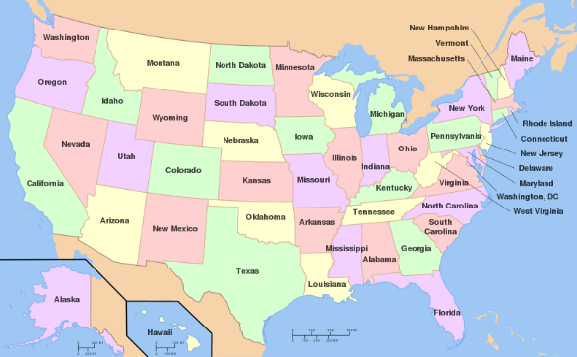
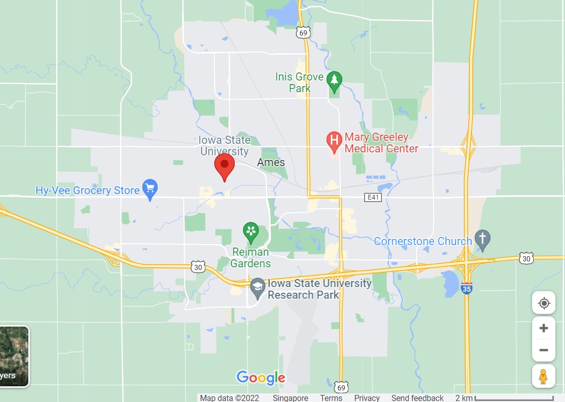
Problem statement | EDA | Regression Model | Variables | Discussion
Where is Ames located geographically?
USA, Iowa
Home to Iowa State University
Notes:
Cindy
Firstly, a short introduction on Ames. It is a city located in Iowa, in United State. It has a population of more than 65,000 and it offers cultural, recreational, educational, business, and entertainment amenities, more commonly in bigger metros
Beneath the small town charm of Ames, Iowa, beats the heart of a much larger city. With a population of more than 65,000, Ames offers cultural, recreational, educational, business, and entertainment amenities more common in bigger metros. As a growing city, Ames continues to focus on building a strong community filled with opportunities for all. There are so many reasons that Ames, Iowa, is the Smart Choice!
In 2015, Ames was named one of the “15 Cities That Have Done the Best Since the Recession” by Bloomberg Business and one of the top 25 “Best Places for STEM Grads.” Ames ranked No. 8 by Niche Ranking for “Best Towns for Millennials in America.” Additionally, USA Today named Ames as the healthiest city in America!

Slide 4
Problem statement | EDA | Regression Model | Variables | Discussion
Method:
To fit a regression model to determine the important determinants of Ames housing sale prices, and identify the most important variables.
Questions to answer:
Which features appear to add the most value to a home?
Which features hurt the value of a home the most?
What are things that homeowners could improve in their homes to increase the value?
What neighborhoods seem like they might be a good investment?
Notes:
Cindy
Our method is to use available past housing sales data of Ames, fitting it into our model to determine which are the important variables that will add value to a home or the opposite, and which neighborhood are more sort after.

Slide 5
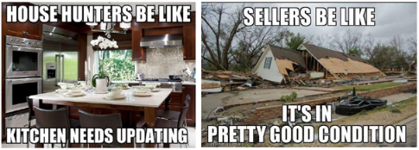
Problem statement | EDA | Regression Model | Variables | Discussion
2 additional observation identifiers: PID and Id
Y variable = SalePrice
Ordinal Variables (Numerical) - 23
E.g. Overall condition of the house rating, overall material and finish rating, Type of utilities available
Nominal Variables (Categorical) - 23
E.g. Type of dwelling, Exterior covering on house, Garage Location
Continuous Variables (Numerical) - 20
E.g. Size of garage, Lot Area, Pool Area
Optional features for houses:
Garage, Pool, Fireplace, Basement, Driveway
Discrete Variables (Numerical) - 14
E.g. Month Sold, Year Sold, Bedrooms Above Grade, Number of Fireplaces
Notes:
Cindy
Now to understand a bit about our raw dataset. It contains more numerical variables than categorical. Some numerical variables examples includes house rating, type of utilities, etc. while categorical examples are neighborhood, exterior material on a house, and more.
We will deepdive into the variable that will impact our model in the next few slides. Now i will hand it over to Shin to explain more in details.

Slide 6
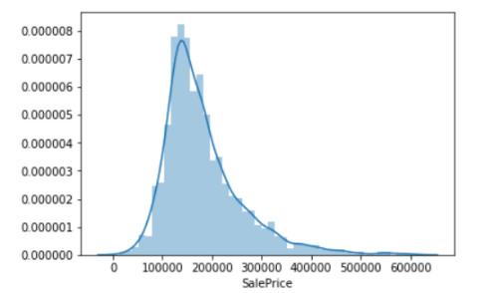
Frequency of Sale Prices in Ames Housing
Problem statement | EDA | Regression Model | Variables | Discussion

Slide 7
Are any variables strongly correlated?
Problem statement | EDA | Regression Model | Variables | Discussion
For numerical data, we need to do something about the multicollinearity:
'Gr Liv Area' and 'TotRms AbvGrd’ (corr = 0.81)
TotRms AbvGrd can be removed as it has a lower correlation to SalePrice
'Garage Cars' and 'Garage Area’ (corr = 0.90)
Garage Area can be removed as Garage Cars is easier to visualize a discrete variable
'Garage Yr Blt' and 'Year Built’ (corr = 0.78)
The Garage and house are usually built in the same year, GarageYrBlt can be removed
'1st Flr SF' and 'Total Bsmt SF’ (corr = 0.79)
The 1st Flr SF and Total Bsmt SF can be combined (with the area of other floors) to form a new variable through feature engineering
Notes:
high multicollinearity
greater living area and total rooms above grade
1st floor square feet and total basement square feet

Slide 8
Final model characteristics
Problem statement | EDA | Regression Model | Variables | Discussion
R²: 0.913
Neighborhood_GrnHill
Neighborhood_StoneBr
MS SubClass_30
MS SubClass_45
MS SubClass_75
Garage Type_NA
Exter Qual
Overall Qual
Kitchen Qual
Garage Cars
Variables with the largest positive coefficients
Variables with the largest negative coefficients
Roof Style_Mansard
Neighborhood_NWAmes
Neighborhood_Gilbert
Neighborhood_SawyerW
Yr Sold
Neighborhood_OldTown
Neighborhood_NAmes
Bedroom AbvGr

Slide 9
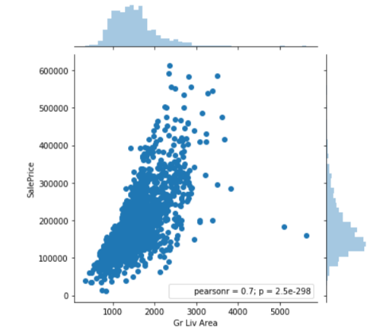
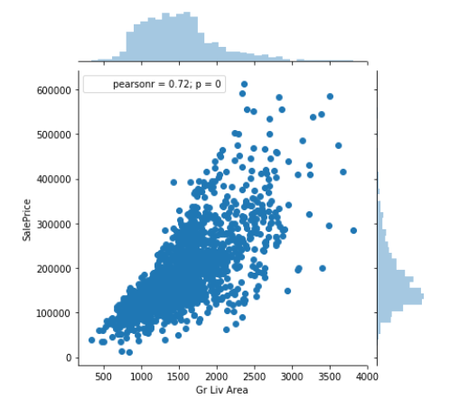
Problem statement | EDA | Regression Model | Variables | Discussion
Continuous Variables (Numerical)
2 houses are outliers as they have the largest areas but low sale prices.
Remove outliers

Slide 10
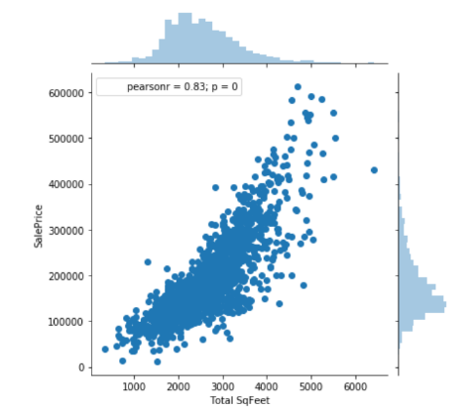
Gr Liv Area (Continuous): Above grade (ground) living area square feet
Problem statement | EDA | Regression Model | Variables | Discussion
Which variable is a better predictor of Sale Price?
Total SqFeet = Total Bsmt SF + 1st Flr SF + 2nd Flr SF
Total Sq Feet (obtained through Feature Engineering)
Correlation between Gr Liv Area and Total Sq Feet = 0.856
> Drop Gr Liv Area
‘Total Sq Feet’ coef | std err
56.8759 | 2.365
Continuous Variables (Numerical)

Slide 11
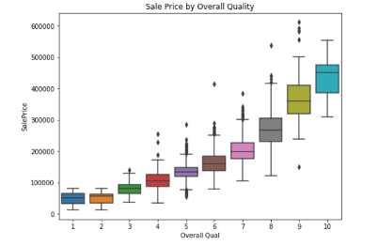
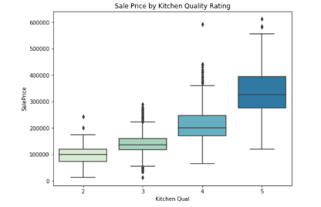
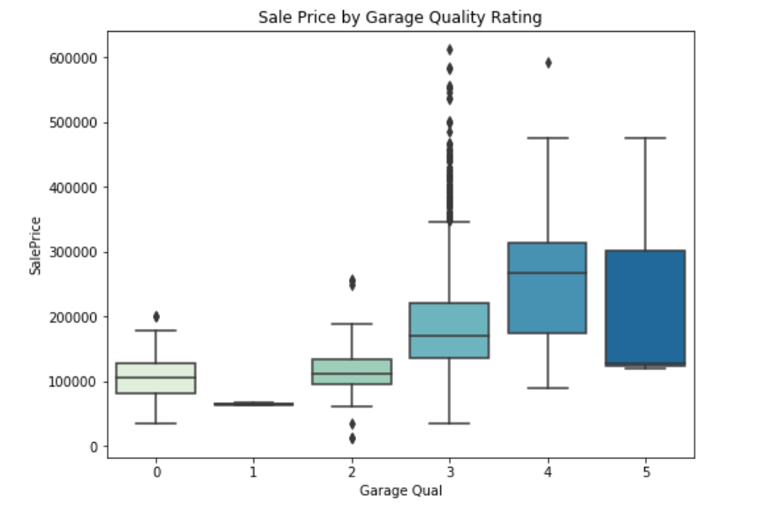
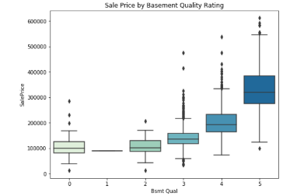
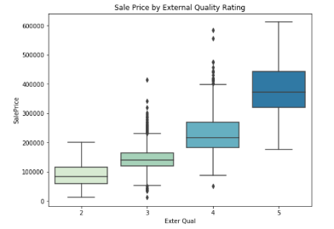
Problem statement | EDA | Regression Model | Variables | Discussion
Better Quality ratings significantly increase Sale Price
Ex Excellent | 5
Gd Good | 4
TA Average/Typical | 3
Fa Fair | 2
Po Poor | 1
 | coef | std err | P>|t|
Garage Qual | 5226.7 | 2163.833 | 0.016
Bsmt Qual | 3220.7 | 1207.866 | 0.008
Overall Qual | 8261.9 | 729.813 | 0
Exter Qual | 9529.8 | 1569.874 | 0
Kitchen Qual | 6539.62 | 1213.78 | 0
Ordinal Variables (Numerical)
Note: ‘0’ means there is no basement

Slide 12
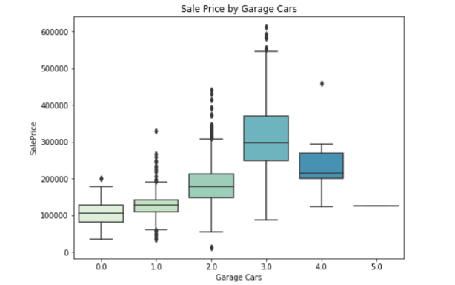
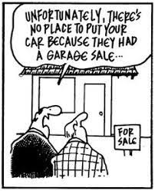
How Garage affects Sale Price The mean sale price of the house peaks at car capacity of 3 and decreases for values of Garage Cars > 3.
Problem statement | EDA | Regression Model | Variables | Discussion
Among houses with a garage, the ones that can afford to have the largest garages tend to be further away from the city where land is cheaper per sq foot, hence overall sale prices are lower.
Variable | coef | std err | t
Garage Type_NA | 2.63E+04 | 6835.559 | 3.846
Garage Cars | 6206.3205 | 1134.808 | 5.469
Discrete Variables (Numerical)

Slide 13
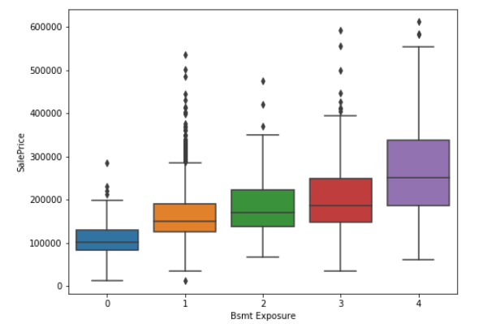
How Basement affects Sale Price Higher Basement exposure rating increases the sale price of a house significantly.
Basement sq feet are inversely related to Sale Price (could be because of maintenance costs).
Problem statement | EDA | Regression Model | Variables | Discussion
Variable | Explanation | coef
Bsmt Exposure | Refers to walkout or garden level walls | 3543.9872
BsmtFin SF 1 | Type 1 finished square feet | -17.0737
BsmtFin SF 2 | Type 2 finished square feet | -30.4843
Bsmt Unf SF | Unfinished square feet of basement area | -40.7742
Discrete Variables (Numerical)

Slide 14
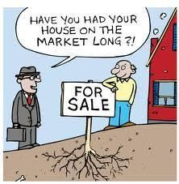
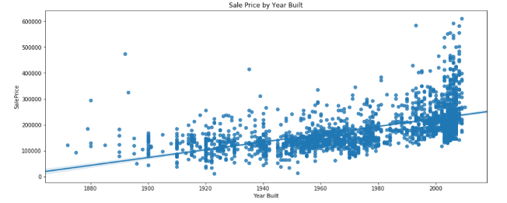
Sale price increase across the years houses are built
- New houses command a higher Sale Price
- Possible inflation of housing prices over years
Problem statement | EDA | Regression Model | Variables | Discussion
 | coef
Year Built | 361.9918
Discrete Variables (Numerical)

Slide 15
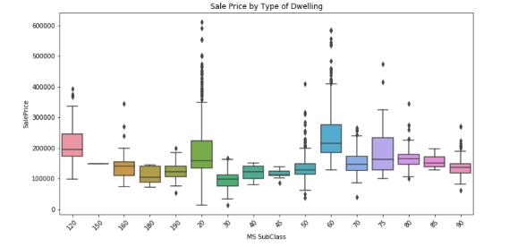
Which type of dwelling tend to have high or low sale prices?
Problem statement | EDA | Regression Model | Variables | Discussion
Variable | Subclass | coef
MS SubClass_30 | 1-STORY 1945 & OLDER | 3.55E+04
MS SubClass_45 | 1-1/2 STORY - UNFINISHED ALL AGES | 3.42E+04
MS SubClass_75 | 2-1/2 STORY ALL AGES | 3.35E+04
MS SubClass_40 | 1-STORY W/FINISHED ATTIC ALL AGES | 3.25E+04
MS SubClass_70 | 2-STORY 1945 & OLDER | 3.02E+04
MS SubClass_50 | 1-1/2 STORY FINISHED ALL AGES | 2.74E+04
MS SubClass_20 | 1-STORY 1946 & NEWER ALL STYLES | 2.64E+04
MS SubClass_60 | 2-STORY 1946 & NEWER | 2.27E+04
MS SubClass_80 | SPLIT OR MULTI-LEVEL | 2.09E+04
MS SubClass_85 | SPLIT FOYER | 2.02E+04
MS SubClass_90 | DUPLEX - ALL STYLES AND AGES | 4338.3159
MS SubClass_150 | 1-1/2 STORY PUD - ALL AGES | -4.57E+04
Nominal Variables (Categorical)

Slide 16
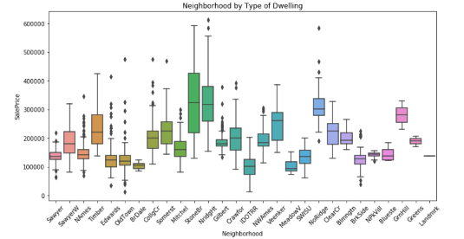
Which neighbourhood in Ames tend to have high or low sale prices?
Problem statement | EDA | Regression Model | Variables | Discussion
 | coef
Neighborhood_Edwards | -4747.9275
Neighborhood_CollgCr | -6993.9083
Neighborhood_Gilbert | -1.09E+04
Neighborhood_GrnHill | 1.12E+05
Neighborhood_NAmes | -7457.669
Neighborhood_NWAmes | -1.56E+04
Neighborhood_NoRidge | 1.35E+04
Neighborhood_NridgHt | 2.39E+04
Neighborhood_OldTown | -8228.4859
Neighborhood_SawyerW | -1.07E+04
Neighborhood_StoneBr | 3.61E+04
Nominal Variables (Categorical)

Slide 17
Applications as a real estate company
Problem statement | EDA | Regression Model | Variables | Discussion
Things homeowners can do to increase the value of the house:
Downsize (or remove) the basement and convert it into general living area
Upgrade the mansard roof to more modern options

Slide 18
Limitations of the model
Problem statement | EDA | Regression Model | Variables | Discussion
Dataset was provided only for a limited time period. It is difficult to predict housing prices on the future because it is heavily dependent on the economy in general.
Model probably cannot be generalised across USA cities because each city has different population size, income levels, etc. We would need to have to adjust the Sale Prices to the income levels and population of each state after finding out the 2 variables’ relationship with housing Sale Price.

Slide 19
Discussion: Possible further improvements
Problem statement | EDA | Regression Model | Variables | Discussion
Can explore outliers to see the characteristics of houses are undervalued
Can explore interaction variables (e.g. Basement Quality x Basement Size, and Subclass x Neighbourhood)
Monthly analysis can be done to find the best month to sell a house for the real estate company. Month should be treated as a categorical variable.

Slide 20
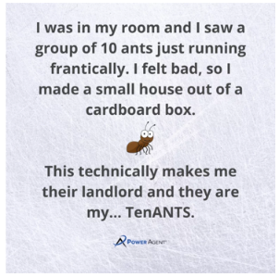
The End (Ant)
Adapted from: https://darrylspeaks.com/bad-dad-jokes-for-real-estate-agents/

